Slide 1
Lesson 11: The OSI model
Mack 2023
Notes:
Last updated 30-11-2021
Resources are updated regularly — the latest version is available at: ncce.io/tcc.
This resource is licensed under the Open Government Licence, version 3. For more information on this licence, see ncce.io/ogl.

Slide 2

The TCP/IP model
Starter activity
Question
Name the four layers of the TCP/IP model and list them in the correct order.
Explorer task
Which layer does the TCP protocol operate in? Describe the function of that layer.

Slide 3
The TCP/IP model
Starter activity
Question
Name the four layers of the TCP/IP model and list them in the correct order.
Answer
Application
Transport
Internet
Link

Slide 4
The TCP/IP model
Starter activity
Explorer task
Which layer does the TCP protocol operate in? Describe the function of that layer.
Answer
The TCP protocol operates in the transport layer. The transport layer breaks data into segments and adds the port destination information.

Slide 5

Lesson 11: The OSI model
Objectives
In this lesson, you will:
Describe the purpose of each layer in the seven-layer Open Systems Interconnection model (OSI model)
Describe the use of contemporary networking protocols in the seven-layer OSI model

Slide 6
The OSI model
Activity 1
Last lesson you learnt all about the TCP/IP model. This is a four-layer model that demonstrates how data is sent and received through a network.
The OSI model is a seven-layer, conceptual model that takes a deeper look at what is happening in some of those layers.

Slide 7
The OSI model
Activity 1
Here are the seven layers of the OSI model. The layers are numbered from bottom to top.
7
Application
6
Presentation
5
Session
4
Transport
3
Network
2
Data link
1
Physical

Slide 8
The OSI model
Activity 1
Here are the seven layers of the OSI model. The layers are numbered from bottom to top.
Just like with TCP/IP, data moves up and down the stack.
Additional data is added as it moves down the stack and data is removed on the way up.
7
Application
6
Presentation
5
Session
4
Transport
3
Network
2
Data link
1
Physical

Slide 9
The OSI model
Activity 1
The process of adding additional data as it moves down the stack is called encapsulation.
The process of removing data as it moves up the stack is called decapsulation.
7
Application
6
Presentation
5
Session
4
Transport
3
Network
2
Data link
1
Physical

Slide 10
The OSI model
Activity 1
OSI
TCP/IP
The top three layers break down the operations that happen within the application layer of the TCP/IP model.
7
Application
Application
6
Presentation
5
Session
4
Transport
3
Network
2
Data link
1
Physical

Slide 11
The OSI model
Activity 1
OSI
TCP/IP
The transport layer performs the exact same operations as the transport layer in the TCP/IP model.
7
Application
Application
6
Presentation
5
Session
4
Transport
Transport
3
Network
2
Data link
1
Physical

Slide 12
The OSI model
Activity 1
OSI
TCP/IP
The network layer performs the exact same operations as the internet layer in the TCP/IP model.
7
Application
Application
6
Presentation
5
Session
4
Transport
Transport
3
Network
Internet
2
Data link
1
Physical

Slide 13
The OSI model
Activity 1
OSI
TCP/IP
The bottom two layers break down the operations that happen in the link layer of the TCP/IP model.
7
Application
Application
6
Presentation
5
Session
4
Transport
Transport
3
Network
Internet
2
Data link
Link
1
Physical

Slide 14
The OSI model
Activity 1
OSI
TCP/IP
The seven-layer OSI model conceptualises what is happening in the application layer of the TCP/IP model by breaking it down into three layers.
7
Application
Application
6
Presentation
5
Session

Slide 15
The OSI model
Activity 1
OSI
The session layer deals with establishing, maintaining and closing a session.
When two end users need to communicate, there are certain protocols that need to be agreed upon.
The session layer agrees those protocols with the end user and creates a session based upon those protocols.
7
Application
6
Presentation
5
Session

Slide 16
The OSI model
Activity 1
OSI
The session is the period of time where the two end users will communicate.
For example:
A session will be created for a client to download a jpeg image from an FTP server.
Once the jpeg has been received correctly, the session will be closed.
7
Application
6
Presentation
5
Session

Slide 17
The OSI model
Activity 1
OSI
The presentation layer deals with presenting the data in the correct format.
For example,
An encrypted image file might have been received by the client. The presentation layer will decrypt the file and display the image using the file format that it was sent in.
7
Application
6
Presentation
5
Session

Slide 18

The OSI model
Activity 1
OSI
The application layer deals with the parts of an application that connect to a network.
It is the closest layer to the end user of the network, and talks directly to the application.
It implements the protocol the client application uses (e.g. HTTP, SMTP, or FTP), to communicate with the server.
7
Application
6
Presentation
5
Session
The applications themselves are not in the application layer.

Slide 19
The OSI model
Activity 1
OSI
TCP/IP
The seven-layer OSI model also conceptualises what is happening in the link layer of the TCP/IP model by breaking it down into two layers.
2
Data link
Link
1
Physical

Slide 20
The OSI model
Activity 1
OSI
The data link layer deals with ensuring that data is transmitted, error free, from one node to another on a network.
In an ethernet network, the data link layer adds MAC addresses to the data to ensure the frame is delivered to the next node.
It then uses the correct protocol for data transfer based on the type of connection between the two nodes.
2
Data link
1
Physical

Slide 21
The OSI model
Activity 1
OSI
The physical layer deals with how the bits of data are physically transmitted through a network.
This could be through light pulses, electrical signals, or radio waves.
The physical layer is concerned with the physical hardware that transmits the signals.
2
Data link
1
Physical

Slide 22
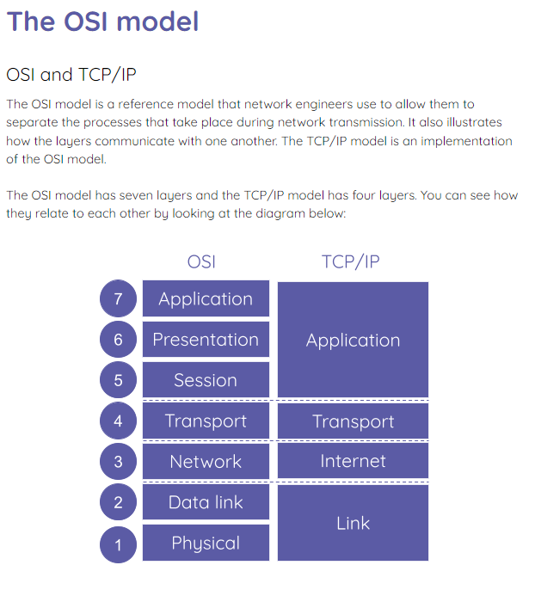
The OSI model: activity
Activity 1
Complete the activity sheet to further explore the OSI model.

Slide 23
Name the missing layers
Wrap Up
Question
Name the layers that are missing from the OSI model.
OSI
TCP/IP
7
Application
Application
6
?
5
?
4
Transport
Transport
3
?
Internet
2
Data link
Link
1
?

Slide 24
Name the missing layers
Wrap Up
Question
Name the layers that are missing from the OSI model.
OSI
TCP/IP
7
Application
Application
6
Presentation
5
?
4
Transport
Transport
3
?
Internet
2
Data link
Link
1
?

Slide 25
Name the missing layers
Wrap Up
Question
Name the layers that are missing from the OSI model.
OSI
TCP/IP
7
Application
Application
6
Presentation
5
Session
4
Transport
Transport
3
?
Internet
2
Data link
Link
1
?

Slide 26
Name the missing layers
Wrap Up
Question
Name the layers that are missing from the OSI model.
OSI
TCP/IP
7
Application
Application
6
Presentation
5
Session
4
Transport
Transport
3
Network
Internet
2
Data link
Link
1
?

Slide 27
Name the missing layers
Wrap Up
Question
Name the layers that are missing from the OSI model.
OSI
TCP/IP
7
Application
Application
6
Presentation
5
Session
4
Transport
Transport
3
Network
Internet
2
Data link
Link
1
Physical

Slide 28
Next lesson
Summary
In this lesson, you…
Learnt about the seven-layer OSI model
Next lesson, you will…
Learn about network security threats

